Slide 1
Where to open a Greek restaurant in New York City? IBM Capstone Data Science Project
By,
Ronald Vieira

Slide 2
Business Problem:
Greek cuisine is the cuisine of Greece and the Greek diaspora.
New York City is commonly known as one of the most popular multicultural centers of the Earth.
With almost 200,000 NYC inhabitants reporting Greek ancestry, the need to find and enjoy Greek cuisine is on the rise.
Location is the key factor when opening a venue. The pandemic caused by Covid- 19 caused the population to move less and to use places near their homes such bakeries, supermarkets, drugstores and restaurants. Despite the lockdown and virus consequences, it is possible to find opportunities in the middle of the pandemic and one of them is to open the right business in the right neighborhood.
Prior to opening a Greek restaurant in any community, it's a good idea to determine how many competitors exist.
This report explores which neighborhoods and boroughs of New York City have the most as well as the best Greek restaurants to answer the main question: Where should I open a Greek restaurant in New York City?
Notes:
Insert a map of your country.

Slide 3
Problem:
To find the answers to the following questions:
Q1) List and visualize all major parts of New York City that have great Greek restaurants.
Q2) what is best location in New York City for Greek Cuisine?
Q3) which areas have potential Greek Restaurant Market?
Q4) which all areas lack Greek Restaurants?
Q5) which is the best place to stay if you prefer Greek Cuisine?
Notes:
Insert a picture of one of the geographic features of your country.

Slide 4
Data Section:
In order to determine the possible options for opening a new restaurant, the data on New York City neighborhoods and boroughs to include boundaries, latitudes, longitudes, restaurants, restaurant ratings and tips are required:
New York City data that contains list Boroughs, Neighborhoods along with their latitude and longitude.
Data source : https://cocl.us/new_york_dataset
Description: This data set contains the required information. And we will use this data set to explore various neighborhoods of New York City
Greek restaurants in each neighborhood of New York City.
Data source : Foursquare API
Description: By using this API we will get all the venues in each neighborhood. We can filter these venues to get only Greek restaurants.
GeoSpace data
Data source : https://data.cityofnewyork.us/City-Government/Borough-Boundaries/tqmj-j8zm
Description: By using this geo space data we will get the New York Borough boundaries that will help us visualize choropleth map.
Notes:
Insert a picture illustrating a season in your country.

Slide 5
Methodology:
Loading all the important libraries that are required to analyze and visualize the data, for example: pandas, numpy, matplotlib, folium, geopy, seaborn and others.
Defining all the python functions to be used to analyze the data.
Collecting the New York city data from the following link https://cocl.us/new_york_dataset. With web scraping using python request library, the data is extracted and transformed in a pandas data frame.
We will find all venues for each neighborhood using Foursquare API. Using the Geocoder libraries, we can convert addresses into latitudes and longitude that are added to the data frame.
We will then filter out all venues with Greek restaurant for further analysis.
Notes:
Insert a picture of an animal and or plant found in your country.

Slide 6
Methodology:
Next using Foursquare API, we will find the Ratings, Tips, and Number of Likes for all the Greek Restaurants.
We will then sort Neighborhoods and Borough’s data keeping Ratings as the constraint.
Next we will consider all the neighborhoods with average rating greater or equal 7.0 to visualize on map.
We will join this dataset to original New York data to get longitude and latitude.
Finally, we will visualize the Neighborhoods and Borough based on average Rating using python’s Folium library.
Notes:
Insert a picture of an animal and or plant found in your country.

Slide 7
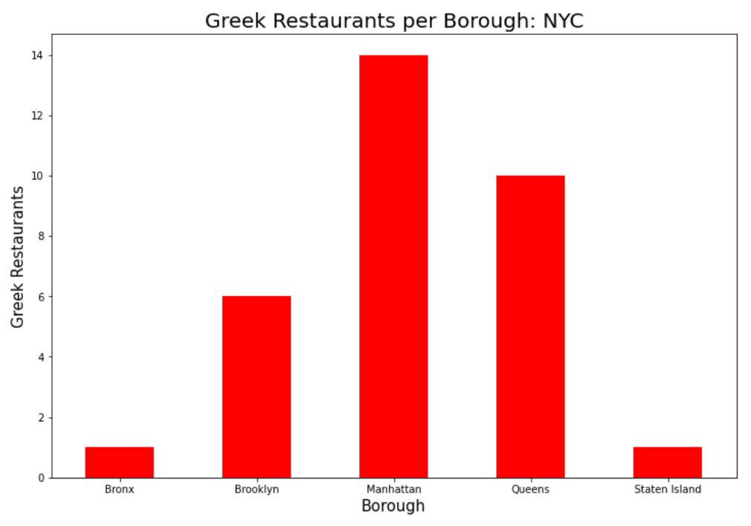
Results:
The Manhattan Borough in New York City has the largest number of Greek restaurants. On the other hand, Bronx and Staten Island have the lowest number of Greek Restaurants:
Notes:
Add key points in the history of your country to the timeline.

Slide 8
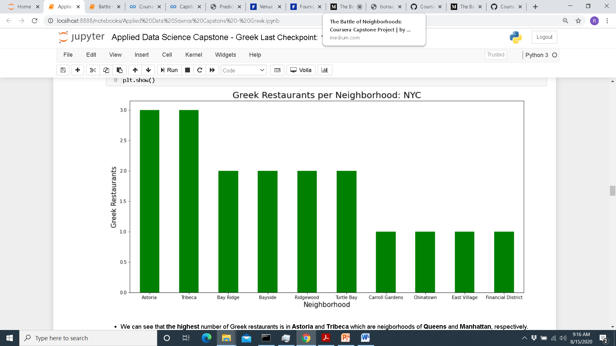
Results:
The Neighborhoods of Tribeca (Manhattan) and Astoria (Queens) have the largest number of Greek restaurants:
Notes:
Add key points in the history of your country to the timeline.

Slide 9
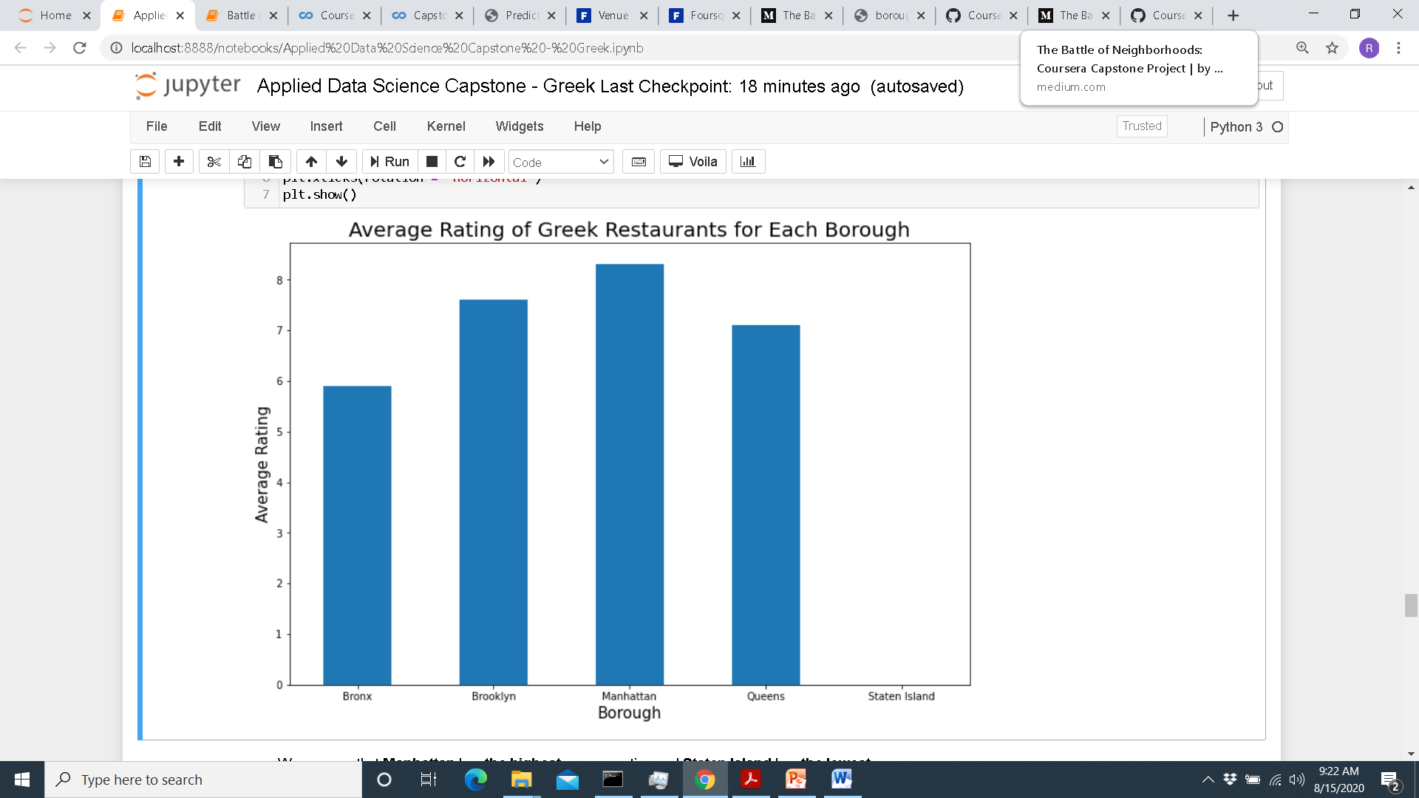
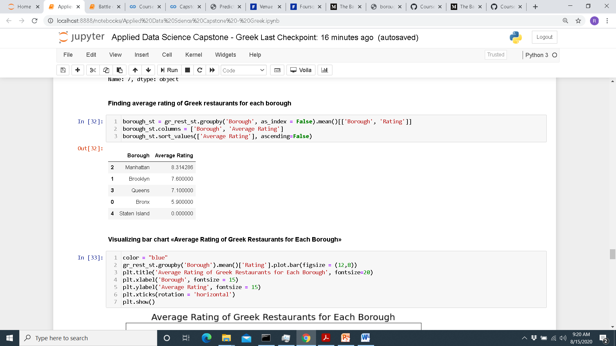
Results:
The Borough of Manhattan have the best rated Greek restaurants in NYC, followed by Brooklyn and Queens:
Notes:
Add key points in the history of your country to the timeline.

Slide 10
Results:
Staten Island ranks last in average rating of Greek Restaurants.
Manhattan is the best place to stay if someone prefers Greek Cuisine.
Notes:
Add key points in the history of your country to the timeline.

Slide 11
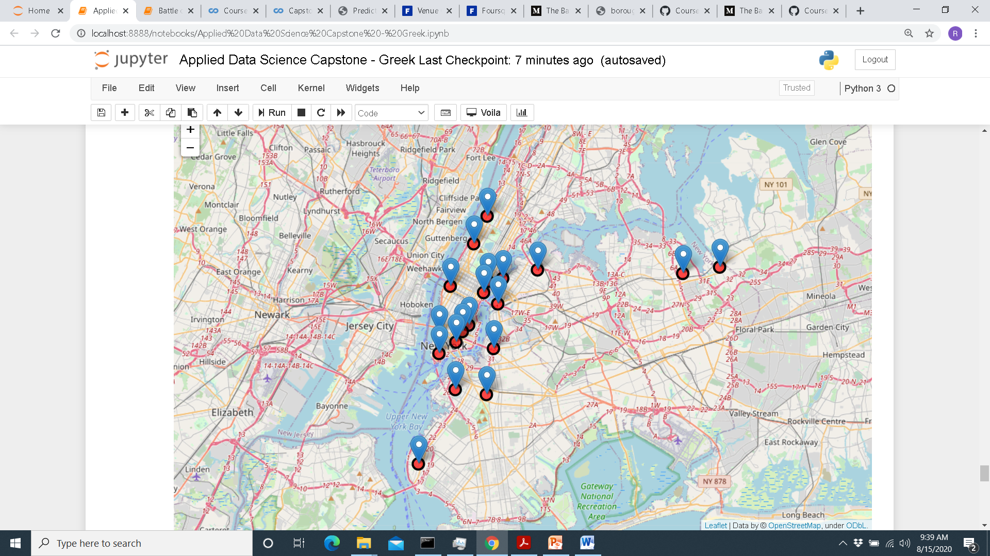
Results:
Map of the neighborhoods of NYV with an average rating greater than or equal to 7
Notes:
Add key points in the history of your country to the timeline.

Slide 12
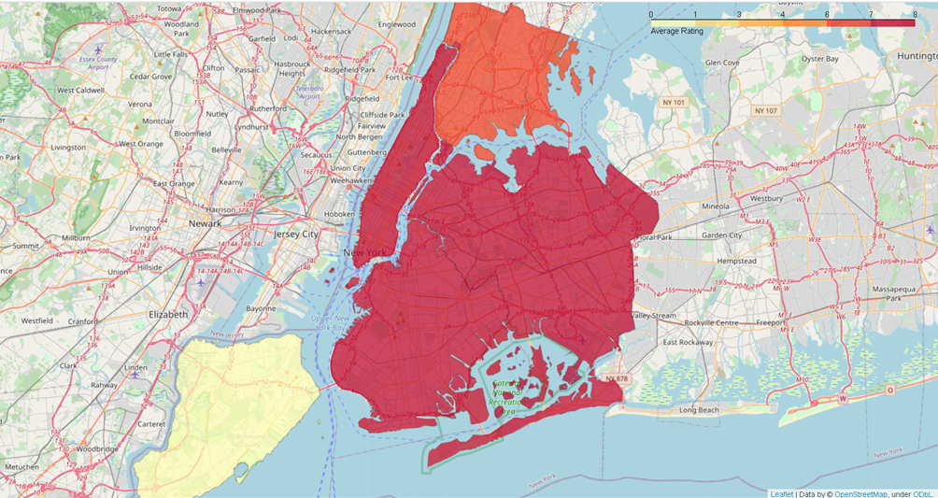
Results:
Borough rating map for Greek restaurants in NYC
Notes:
Add key points in the history of your country to the timeline.

Slide 13
Discussion:
It can be said that Manhattan is the best locations for Greek cuisine in NYC.
To have the best chance of success, I would recommend opening a Greek restaurant in Brooklyn. Brooklyn has neighborhoods with average ratings exceeding 7.0 of a scale of 1.0 to 10.0 and has the least number of Greek restaurants making competition easier than in other boroughs, such as Manhattan.
Finally, I can consider Gyro King, Blue Door Souvlakia and Elia Restaurant as the most suitable places to try Greek cuisine.
Notes:
Insert a picture of an animal and or plant found in your country.

Slide 14
Conclusion:
The project gone through the processes of identifying a problem, specifying the required data, extract, prepare the data and provide a recommendation based on result gathered data analysis.
All the above research is highly depended on the adequacy and accuracy of Foursquare Database, therefore, a more comprehensive analysis and future work would need to incorporate data from other external databases.
We must keep in mind that we only considered the frequency of occurrence factor and for further analysis we should use other factors to have a more precise recommendation. The results of this project will help who wants to open a Greek restaurant in New York City.
Notes:
Insert a picture of an animal and or plant found in your country.

